Slide 1
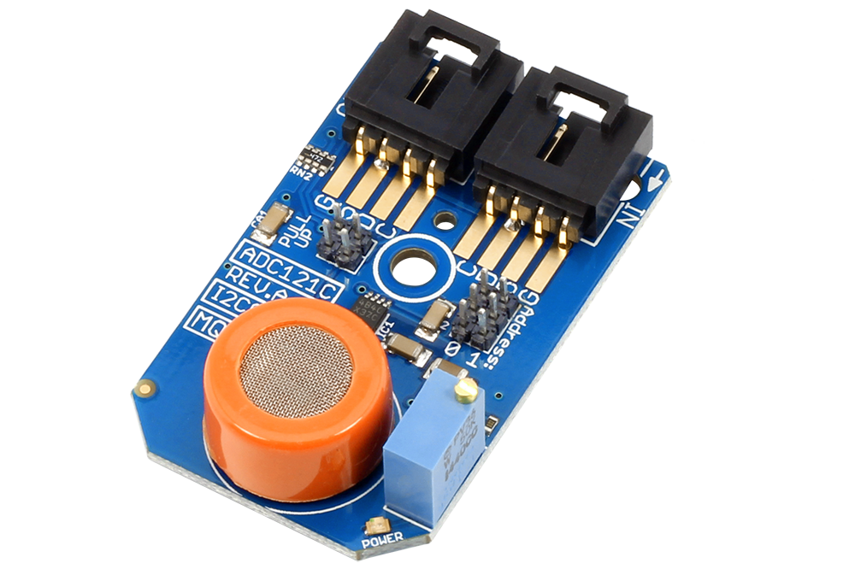
MQ3 Sensor : Breathalyzer
BY : MOHITA PRABHAKAR

Slide 2
introduction
MQ3 sensor or alcohol sensor is suitable for detecting alcohol concentration on breath, just like common breathalyzer
.It has a high sensitivity and fast response time. Sensor provides an analog resistive output based on alcohol concentration.
This Sensor will be used with the app known as Breathalyzer which is made for personal use for self control or general health issues.

Slide 3
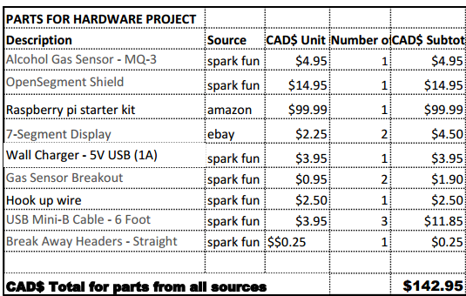
Budget
I bought some minor extra stuff for my project since my new SD card wasn’t working with the raspberry pi.
But the overall budget was almost the same

Slide 4

Schedule

Slide 5
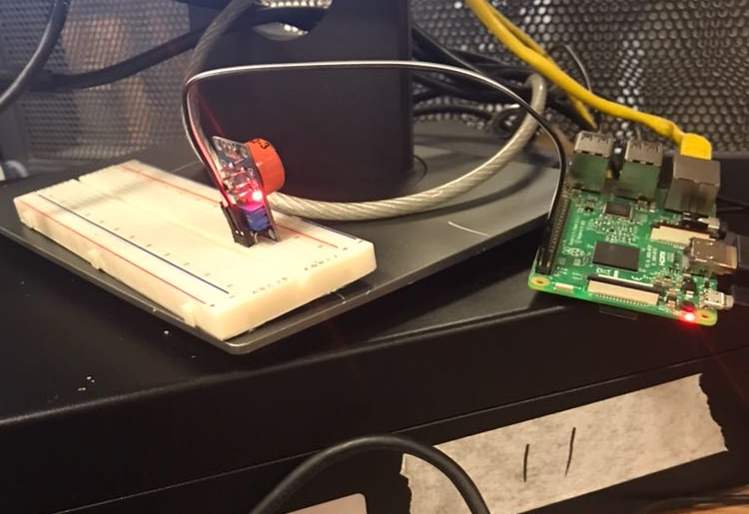
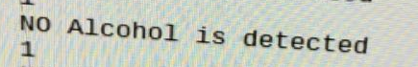
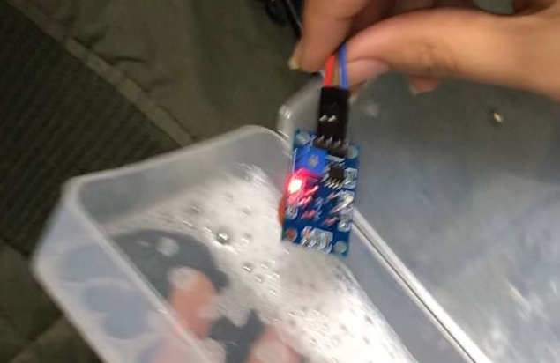
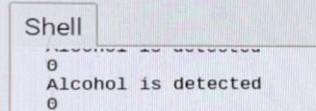
Proof of working sensor

Slide 6

Build video

Slide 7
Knowledge from the previous courses
TECH 153:- We became familiar to Raspberry pi
Tech 101:- Familiar to work with electronic circuits
CENG216:-Made familiar to Gantt Chart , choose the project type

Slide 8
Thank you

